Slide 1
Concurrent and Parallel Systems Processes and threads
Dr Sergio Davies <sergio.davies@shu.ac.uk>
Department of computing
Sheffield Hallam University
4 October 2022

Slide 2
TUTORIAL: Parallelising matrix multiplication
Parallelisation per column

Slide 3
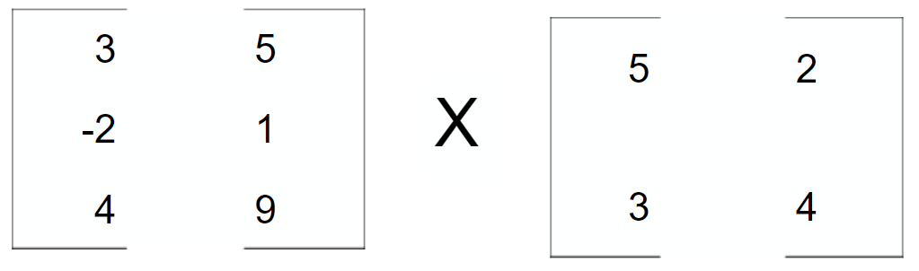
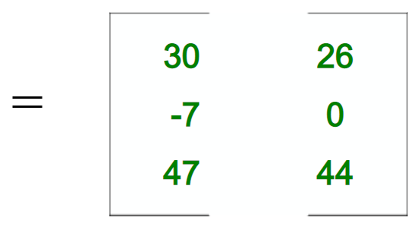
Executing the multiplication
Last tutorial session:
Thread 1

Slide 4
Executing the multiplication
This tutorial session:
Thread 1
Thread 2

Slide 5
Executing the multiplication

Slide 6
Tutorial session
Develop a software which computes the matrix multiplication, dividing the destination matrix in sections assigning the computation of each section to a different thread
Read source matrices from file;
Check if the two matrices can be multiplied;
Perform multiplication;
Spawn multiple threads (min. 2 – max. one per column of source matrix);
Perform computation;
Write destination matrix to file;

Slide 7
Important considerations
Number of threads?
May be requested to the user
May be defined by the number of cores in the PC
Experiment with this!
When dividing the source matrix, what to do with fringes?

